Slide 1
Weather Forecasting using Probabilistic Graphical Models
Spring 2014 – Probabilistic Graphical Models (10708)
Felipe Hernández and Amos Ng
Professor: Eric Xing
TA mentor: Dai Wei

Slide 2
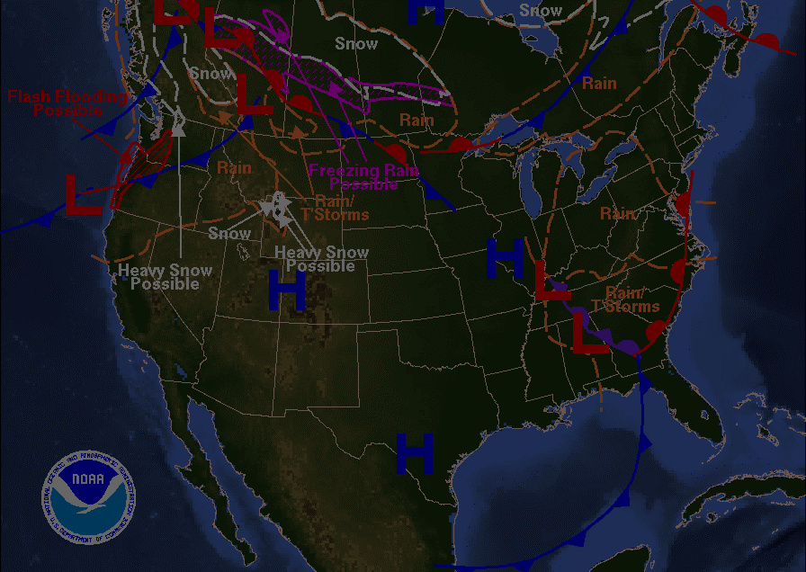
Weather forecasting
Physically-based global models
Physically-based local models
Artificial Neural Networks (ANN)
Fused ANN: support vector regression, particle swarm optimization, genetic algorithms, etc.
ANN-based: neuro-fuzzy models (NFM)
Fused NFM: wavelet transforms, genetic programming, etc.
Linear regression, discriminant analysis, logistic regression, etc.

Slide 3
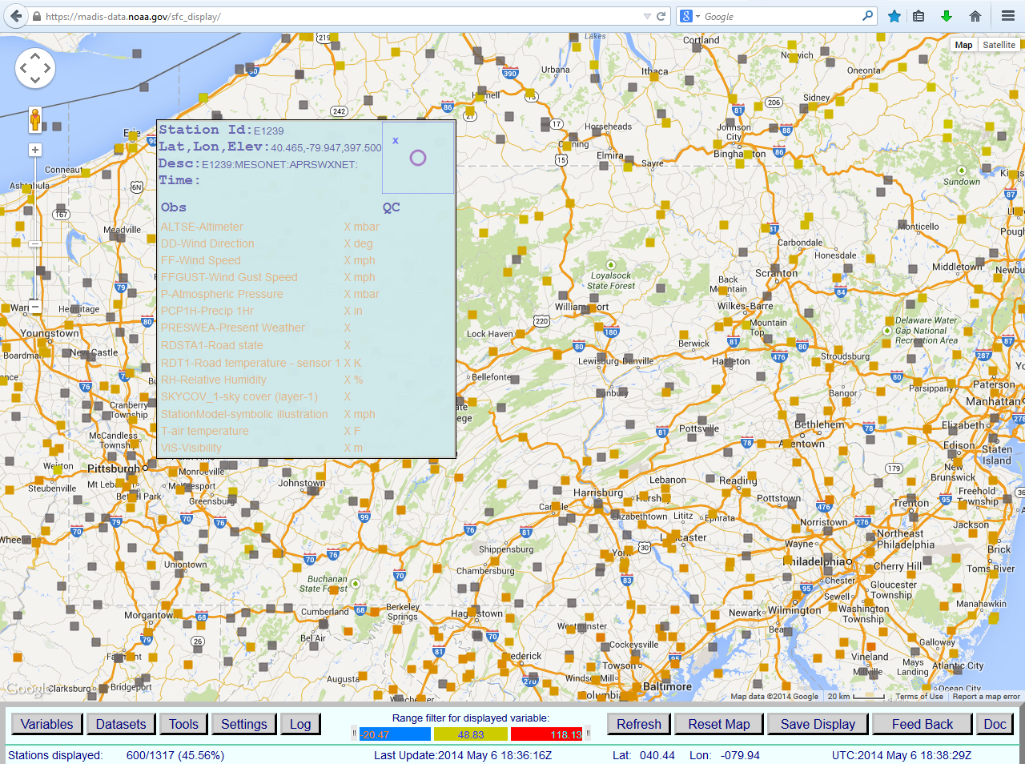

Slide 4
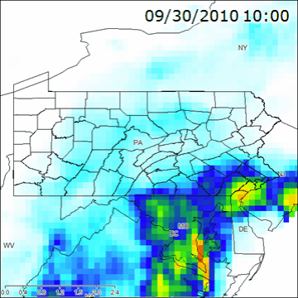
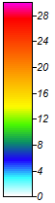
NLDAS-2 dataset
1 hour accumulated rainfall (mm)

Slide 5
NLDAS-2 dataset
Name | Description | Units
precipitation | Accumulated height of precipitated water column | millimeters
available potential energy | 180-0 mb above ground Convective Available Potential Energy | Joules per kilogram
% convective precipitation | Fraction of total precipitation that is convective | none
LW radiation | Long wave radiation flux downwards (surface) | watts per square meter
SW radiation | Short wave radiation flux downwards (surface) | watts per square meter
potential evaporation | Potential evaporation | millimeters
surface pressure | Surface pressure | pascals
specific humidity | 2 m above ground Specific humidity | none
temperature 2 m | 2 m above ground Temperature | kelvin
zonal wind speed | 10 m above ground Zonal wind speed | meters per second
meridional wind speed | 10 m above ground Meridional wind speed | meters per second

Slide 6
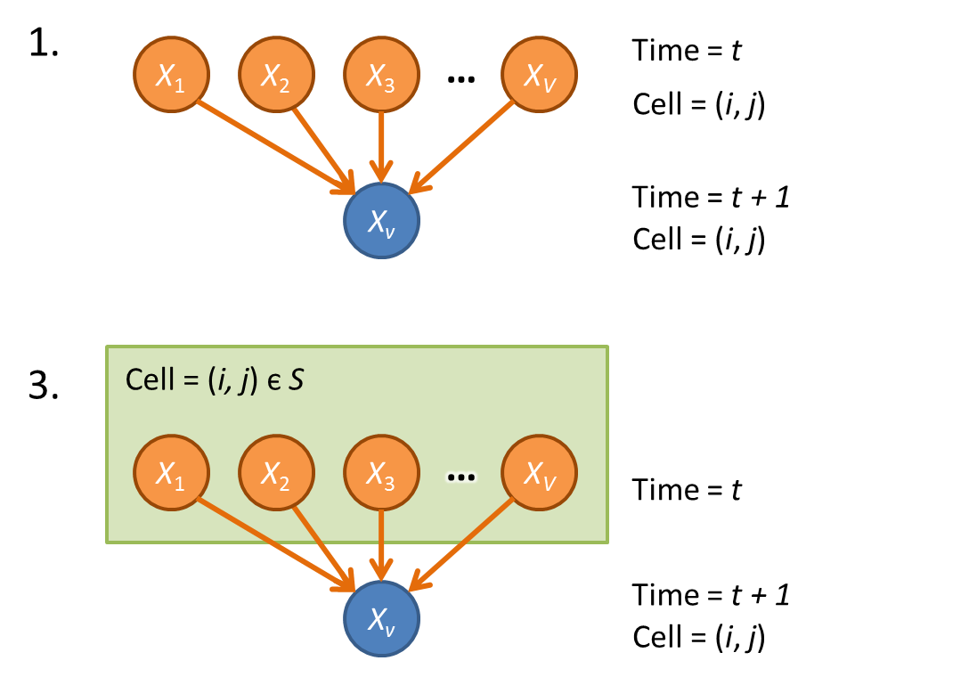
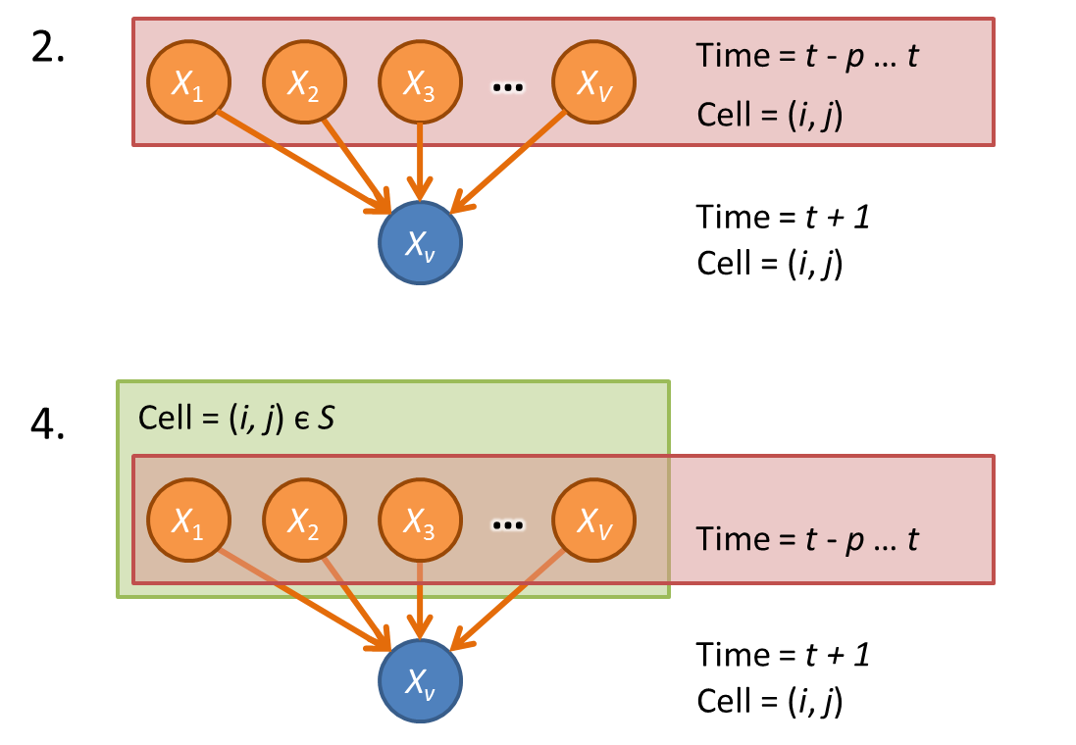
Forecasting task

Slide 7
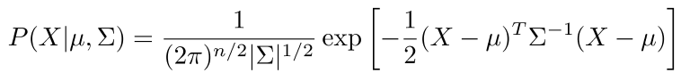
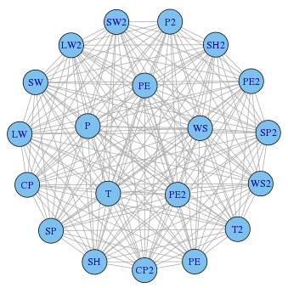
Gaussian Graphical Models
Learning Σ = Ω⁻¹:
Empirical covariance matrix
Neighborhood lasso (Meinshausen & Bulhmann, 2006)
Graphical lasso (Friedman et al., 2008)

Slide 8
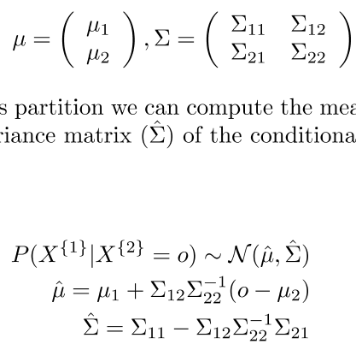
Gaussian Graphical Models
Inference:
Naïve matrix inversion
Belief propagation (graph with no cycles)
Loopy belief propagation (graph with cycles)
Enhanced belief propagation (Malioutov, 2008)

Slide 9
Case study
Square area around Pittsburgh of around 60 km x 60 km (-80.31° < E < -79.69°, (40.19° < N < 40.81°)
6 x 6 pixels = 36 pixels
A month of data: from 9/15/2010 – 10/14/2010
720 time steps
720 x 36 = 25,920 training examples
10 original variables + gradients

Slide 10
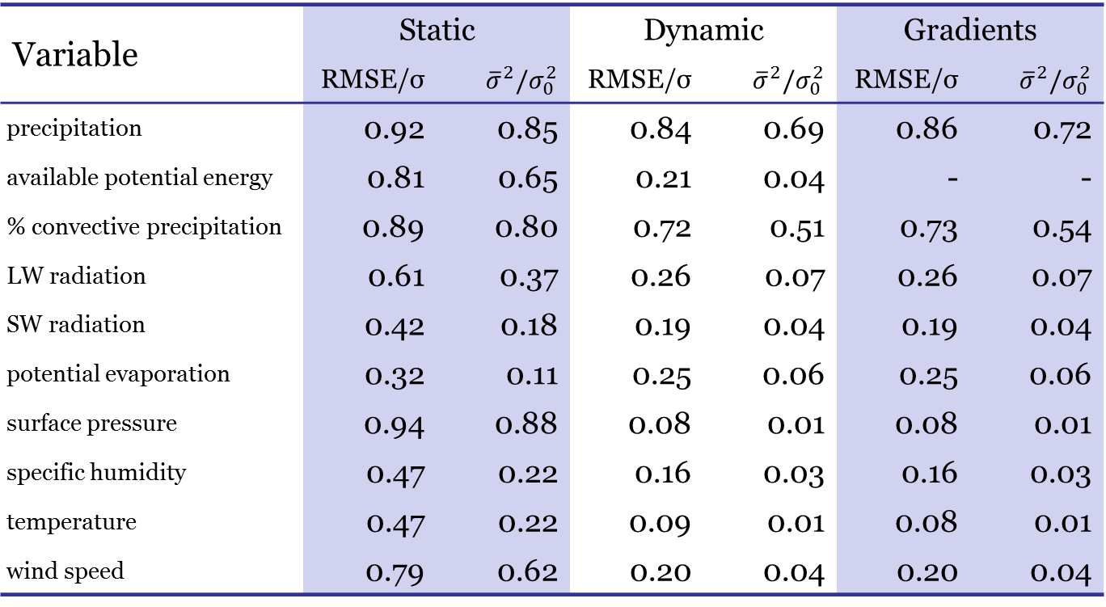
Results - unregularized
Variable | Static |  | Dynamic |  | Gradients
 | RMSE/σ | $${\overline{σ}}^{2}/σ_{0}^{2}$$ | RMSE/σ | $${\overline{σ}}^{2}/σ_{0}^{2}$$ | RMSE/σ | $${\overline{σ}}^{2}/σ_{0}^{2}$$
precipitation | 0.92 | 0.85 | 0.84 | 0.69 | 0.86 | 0.72
available potential energy | 0.81 | 0.65 | 0.21 | 0.04 | - | -
% convective precipitation | 0.89 | 0.80 | 0.72 | 0.51 | 0.73 | 0.54
LW radiation | 0.61 | 0.37 | 0.26 | 0.07 | 0.26 | 0.07
SW radiation | 0.42 | 0.18 | 0.19 | 0.04 | 0.19 | 0.04
potential evaporation | 0.32 | 0.11 | 0.25 | 0.06 | 0.25 | 0.06
surface pressure | 0.94 | 0.88 | 0.08 | 0.01 | 0.08 | 0.01
specific humidity | 0.47 | 0.22 | 0.16 | 0.03 | 0.16 | 0.03
temperature | 0.47 | 0.22 | 0.09 | 0.01 | 0.08 | 0.01
wind speed | 0.79 | 0.62 | 0.20 | 0.04 | 0.20 | 0.04

Slide 11
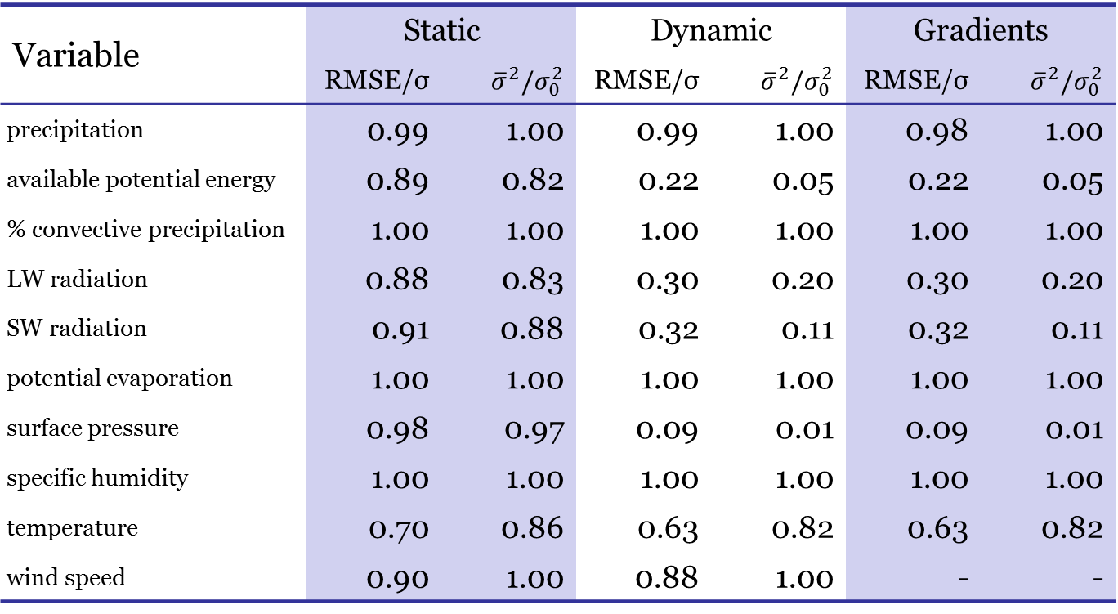
Results - regularized
Variable | Static |  | Dynamic |  | Gradients
 | RMSE/σ | $${\overline{σ}}^{2}/σ_{0}^{2}$$ | RMSE/σ | $${\overline{σ}}^{2}/σ_{0}^{2}$$ | RMSE/σ | $${\overline{σ}}^{2}/σ_{0}^{2}$$
precipitation | 0.99 | 1.00 | 0.99 | 1.00 | 0.98 | 1.00
available potential energy | 0.89 | 0.82 | 0.22 | 0.05 | 0.22 | 0.05
% convective precipitation | 1.00 | 1.00 | 1.00 | 1.00 | 1.00 | 1.00
LW radiation | 0.88 | 0.83 | 0.30 | 0.20 | 0.30 | 0.20
SW radiation | 0.91 | 0.88 | 0.32 | 0.11 | 0.32 | 0.11
potential evaporation | 1.00 | 1.00 | 1.00 | 1.00 | 1.00 | 1.00
surface pressure | 0.98 | 0.97 | 0.09 | 0.01 | 0.09 | 0.01
specific humidity | 1.00 | 1.00 | 1.00 | 1.00 | 1.00 | 1.00
temperature | 0.70 | 0.86 | 0.63 | 0.82 | 0.63 | 0.82
wind speed | 0.90 | 1.00 | 0.88 | 1.00 | - | -

Slide 12
Conclusions
Accuracy is still too low
Some variables are more easily forecasted
Gradients do not increase prediction accuracy significantly
Graphical model offers a very good measure of the uncertainty of the prediction
A more expressive model is required (polynomial terms?)
Different methods to account for neighbors

Slide 13
Weather Forecasting using Probabilistic Graphical Models
Spring 2014 – Probabilistic Graphical Models (10708)
Felipe Hernández and Amos Ng
Professor: Eric Xing
TA mentor: Dai Wei

